Slide 1
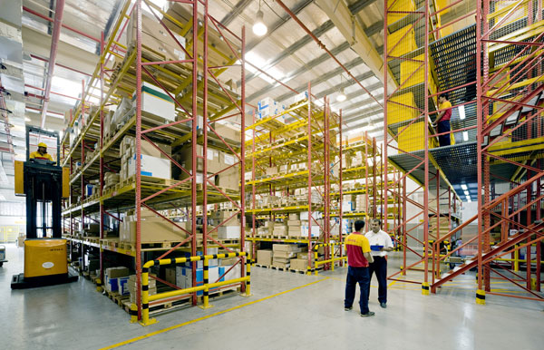
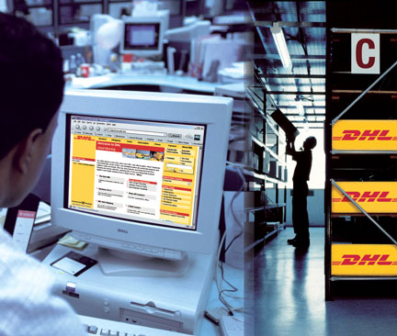

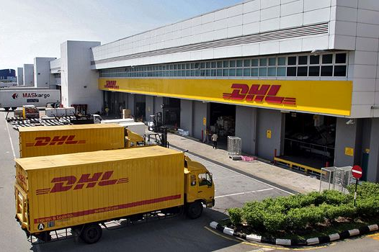

กรมพัฒนาฝีมือแรงงาน
ผศ.ดร.บุญมา ชัยเสถียรทรัพย์
18 พฤศจิกายน 2558
BD & SD Thailand Team
BD & SD Thailand Team

Slide 2
Logistics in Thailand
Cost of THB 1,835,000 Millions in 2013 or 14.2% of GDP
> 18,000 logistics companies
Source: NESDB

Slide 3
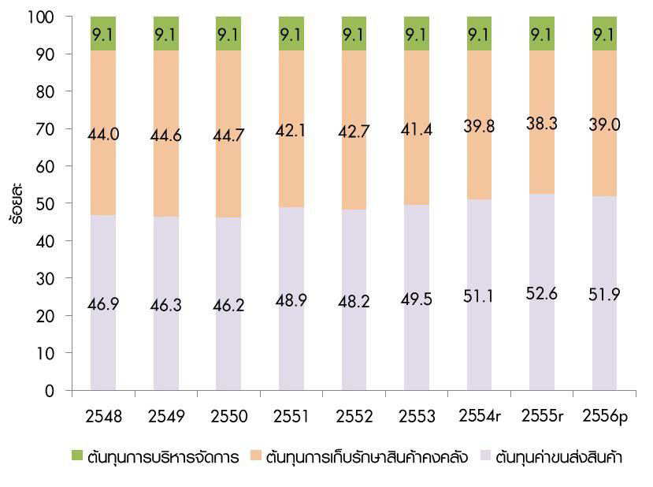
Logistics in Thailand
Cost structure; Transportation 51.9%, Storage 39%, and Management at 9.1%
Domestic Transport includes 80% of land transport, 17.4% of marine, 2.2% of rail transport, and 0.02% of air transport
Source: NESDB

Slide 4
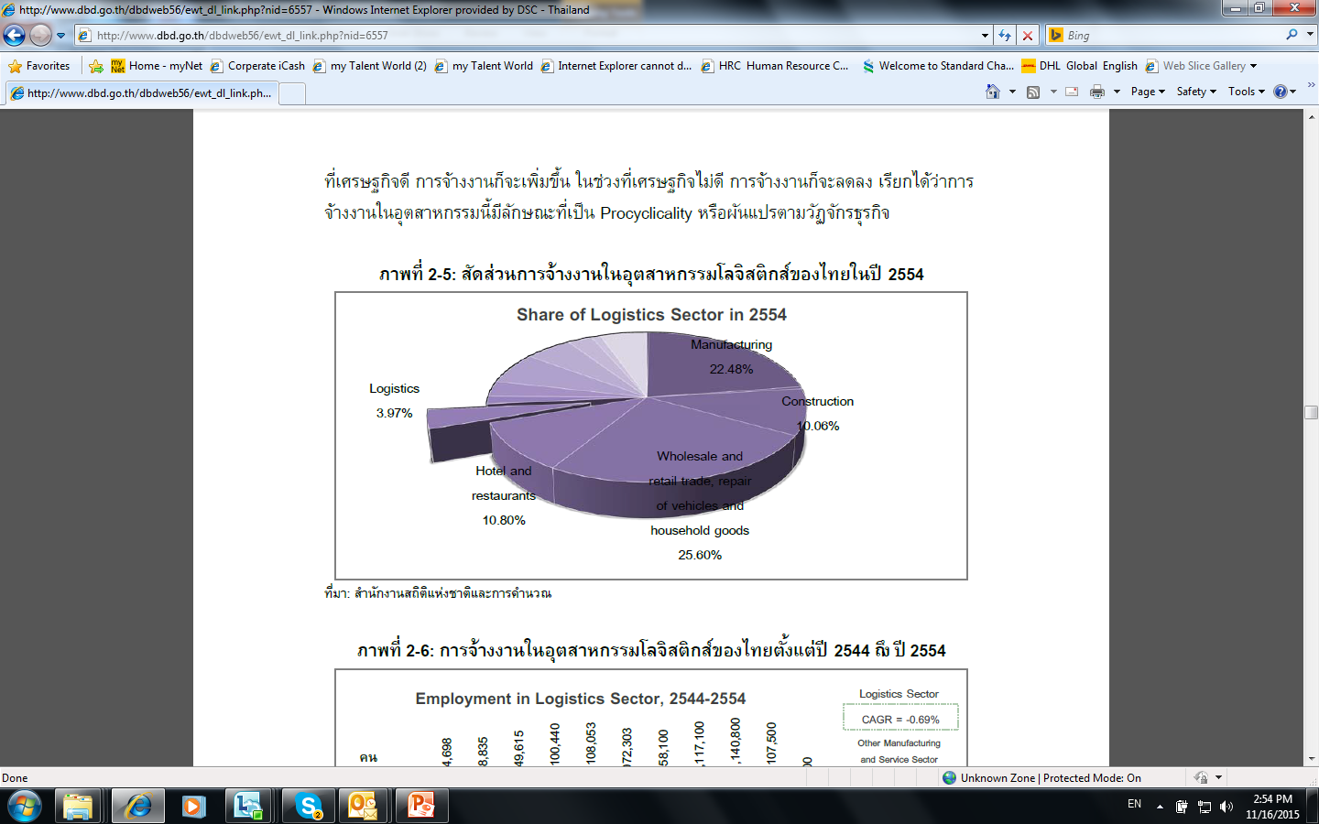
Logistics in Thailand
around 1 million of workforce employed within logistics sector, mainly wholesale, retail, household goods business.

Slide 5






Supply Chain management
Integrated End-to-End Supply Chain
Local and/or Imported Raw Materials and/or Finished Goods
Inbound Transport
Warehousing/ Distribution Centers
Outbound Transport
B2B & B2C Distribution
After-Sales Services
Core Activities
Location, Layout, & Mgt
Material Handlings
Receiving
Put away
Picking
Co Packing,
Labeling, Kitting
Dispatching
Stocking
Demand Planning
Inventory Planning
Ordering
Replenishment
Disposal Management
WMS
Transport Mgt System
System integration
Tracking System
e.g. GPS, RFID, Telematics
Inventory Management
Information System & Technology
Warehousing
Warehouse Management System
Transport Management System
GPS (web tracking)
Order & Document Management
Performance Measures
Process & Cost Improvement
Security, Health & Safety
Project Management
Environment & Waste Mgt
Business Contingency
Transportation Model
Planning & Scheduling
Fleet Management
Driver Management
Solutions Design
Operational Efficiency
Transportation

Slide 6




some of The future trends(1/2)
The internet has become a global market place for online shoppers across borders.
E-Commerce
Reliable transit times and delivery
Single point of contact convenience
Fully managed customs clearance available
End-to-end online shipment visibility available
E-Commerce
Waste Management
Collect and recycle waste streams to convert cost into revenue streams
and support ‘zero waste’ targets
Envirosolutions
6
Supply Chain Mega Trends | 4 September 2014

Slide 7


some of the future trends (2/2)
A variety of automated systems within its warehouse offering, all of which are designed to bring significant efficiencies to business’’ operations
“City Logistics” provides advanced logistics services not only reducing emissions but also helping local businesses achieve their full potential by more efficient transport management
Example: urban freight centers decreasing freight traffic, increasing the quality of air, improving efficiency, and offering a better control of the logistics processes by a higher visibility of the supply chain
City Logistics
Examples:
Goods identification e.g. RFID tag, sortation
Sensor and data capture devices e.g. voice picking
Handling devices e.g. automatic order selectors
Storing devices e.g. WMS, inventory visibility
Automation
7
Supply Chain Mega Trends | 4 September 2014
Notes:
“By 2050, more than 70 per cent of the world population will live in cities, and with our global City Logistics program we develop solutions for more efficient logistics in these growing cities”, says Bill Meahl, Chief Commercial Officer DHL.
DHL is already engaged with a number of local governments in municipalities around the world regarding City Logistics. Together with various technical partners – which include Siemens AG, DLR, SAP and Turkcell – the DHL City Logistics teams are working on the next generation of optimization in urban logistics and traffic flows.

Slide 8
Key highlights
On going labor shortage at operative level.
Much higher labor costs both blue collar and professionals.
Significant turnover resulting in hiring and training costs.
Labor intensive, technology and automation need to be leveraged
Quality & behaviors of truck drivers in the market
Soft and technical skills
Country infrastructure; road, traffic, and others
Operational efficiency and improvement
8
Supply Chain Mega Trends | 4 September 2014
Notes:
“By 2050, more than 70 per cent of the world population will live in cities, and with our global City Logistics program we develop solutions for more efficient logistics in these growing cities”, says Bill Meahl, Chief Commercial Officer DHL.
DHL is already engaged with a number of local governments in municipalities around the world regarding City Logistics. Together with various technical partners – which include Siemens AG, DLR, SAP and Turkcell – the DHL City Logistics teams are working on the next generation of optimization in urban logistics and traffic flows.

Slide 9
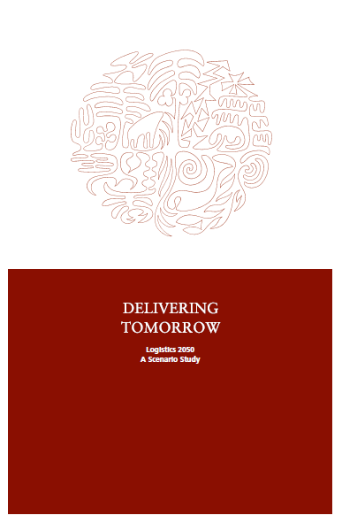
DPDHL Whitepaper
PUBLISHER
Deutsche Post AG, Headquarters
represented by Dr. Christof E. Ehrhart,
Executive Vice President Corporate Communications
53250 Bonn, Germany
PROJECT DIRECTOR
Dr. Jan Dietrich Müller,
Corporate Communications, Deutsche Post AG
PROJECT MANAGEMENT AND EDITORIAL OFFICE
Johannes Oppolzer,
Corporate Communications, Deutsche Post AG
February 2012

Slide 10

Logistics 2050 scenarios - overview
1
Untamed Economy – Impending Collapse
2
Mega-efficiency in Megacities
3
Customized Lifestyles
4
Paralyzing Protectionism
5
Global Resilience – Local Adaptation
10
10
Supply Chain Mega Trends | 4 September 2014

Slide 11
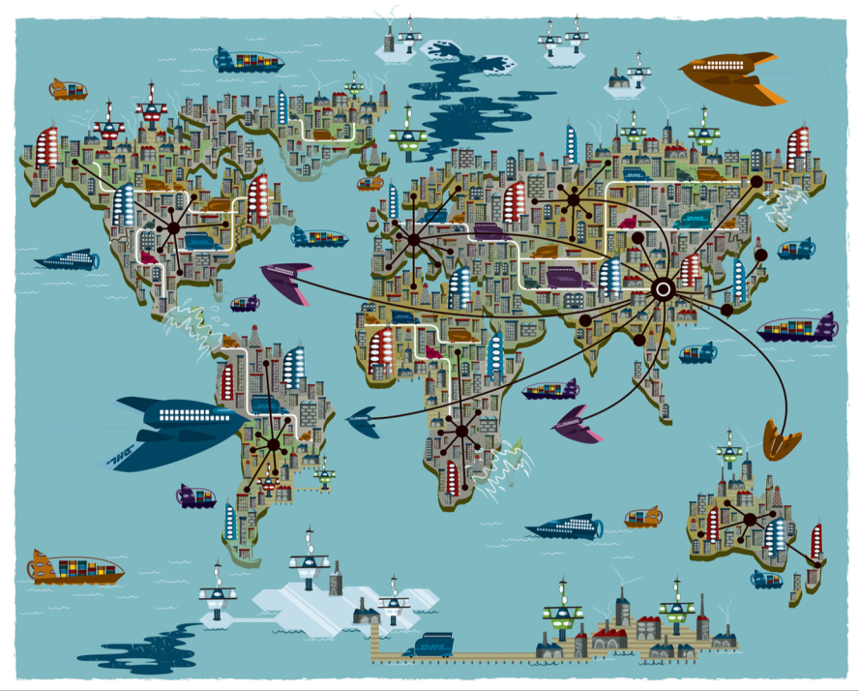
Scenario 1: Untamed economy – impending collapse
Key Elements
Szenario 1: Untamed Economy – Impending Collapse
Unsustainable economic development
World driven by materialism
Economic shift to Asian and emerging countries
Trade barriers lifted
Global “supergrid” for transport
Uncontrolled exploitation of natural resources
Destruction of natural environments
Logistics Implications
Massively increased global logistics market
Manufacturers outsource their logistics needs
Climate change opens arctic trade corridors
Extreme weather events threaten established trade routes and raise capital costs for logistics company

Slide 12






Scenario 1: Untamed economy – impending collapse
Constant race for resource extraction leads to destruction of ecosystems
Szenario 1: Untamed Economy – Impending Collapse
Arctic routes have become navigable
Center of economic power has shifted to Asia
Former developing countries have turned into high-tech locations
Vessel size far bigger than before
Extreme events have increased noticeably

Slide 13
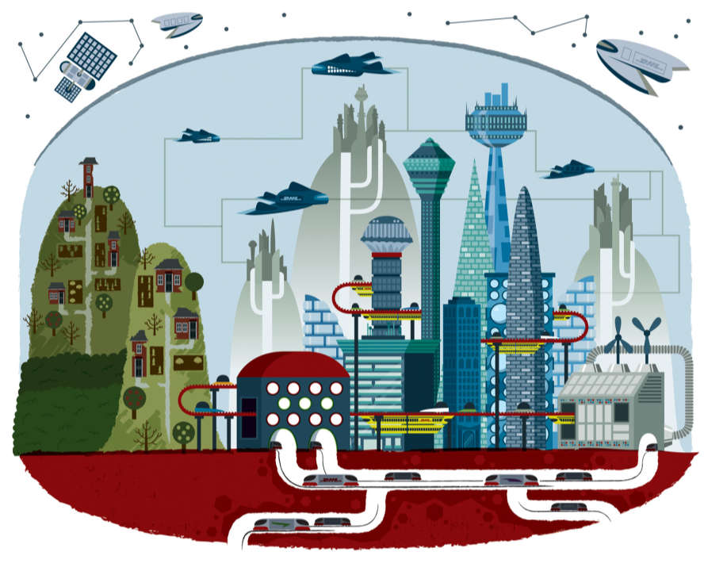
Scenario 2: Mega-efficiency in Megacities
Logistics Implications
Szenario 2: Megaefficiency in Megacities
Key Elements
Global transport with mega-transporters between megacities
Unmanned low orbit transporters for express deliveries
Freight dispatch centers in cities to pool goods
New transport modes like underground cargo transporters
Electric vehicles for deliveries
Logistics providers become megacity utilities
Advanced logistics services encompass the fast and reliable delivery of goods as well as the safe transfer of information and knowledge
Logistics situation in rural areas very poor
Megacities have become epicenters of green growth
Nation-states have become second-tier players
Production and services highly automated
Manufacturing in robotized plants
Efficient transport concepts for local and global connections
However: rural regions left economically behind

Slide 14






Scenario 2: Mega-efficiency in Megacities
Szenario 2: Megaefficiency in Megacities
Unmanned low orbit transporters allow quick point-to-point express delivery
Huge unmanned cargo planes
Majority of population resides in urban areas by 2050
Widening gap between urban and rural areas
New types of transportation in cities
Megacities are well connected to the other megacities worldwide

Slide 15
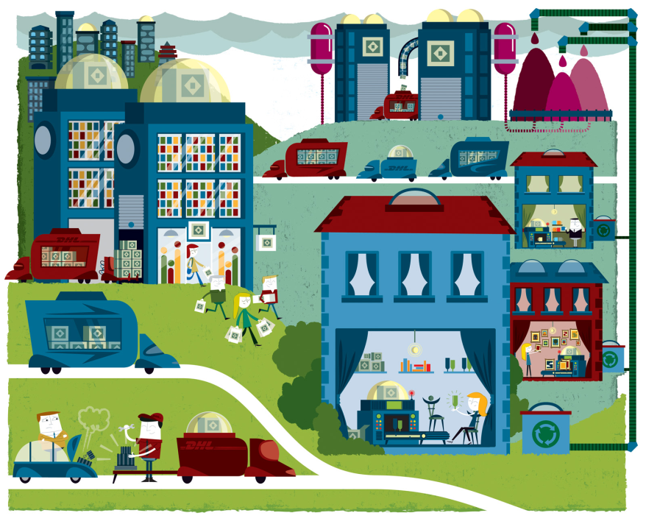
Scenario 3: Customized Lifestyles
Key Elements
Logistics Implications
Szenario 3: Customized Lifestyles
Individualization has become a pervasive phenomenon
Consumers empowered to design their own products
Technological progress:
  Home Fabbing
  Local FabShops
  Industrial Fabbing
Regionalized trade, local product flows
International trade of data and raw materials (for printers)
Long distance transport of goods drops sharply
Regional logistics capabilities important
Supply chains less fragmented
Logistics in 2050 consists of an online and an offline element:
  Offline segment: raw material transport & reverse logistics
  Online segment for secure data transfer
15

Slide 16




Scenario 3: Customized Lifestyles
Raw material logistics that serves 3D printing cartridge manufacturers
More sophisticated items produced in fab shops
Billions of households owning a home 3D-printer in 2050
Mobile
3D printing

Slide 17
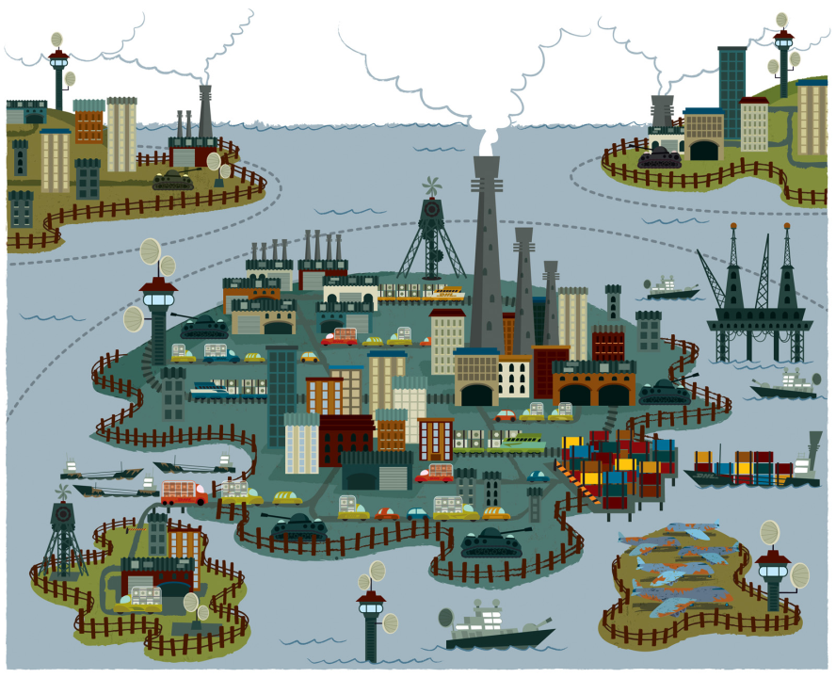
Scenario 4: Paralyzing Protectionism
Logistics Implications
Szenario 4: Paralyzing Protectionism
Key Elements
Entering markets in foreign trading blocs nearly impossible
Substantially reduced volume for global logistics operations
Domestic markets gain importance
Advantages for regional champions with good government relations
“Devaluation” of logistics: Few customized solutions – very commoditized business
Economic hardship sets globalization in reverse
Trading mainly within regional blocs
Regionalized supply chains
Productivity decline
Scarce resources (also due to protectionism)
International conflicts over resource deposits as result

Slide 18







Scenario 4: Paralyzing Protectionism
Szenario 4: Paralyzing Protectionism
Switch to locally available energy sources
Almost no exchange of goods between different regions
Resource extraction has increased
Threat of small conflicts connected with resource deposits
Clearing customs can take several weeks.
Protectionism is common practice
International express and forwarding segment shrinking
18

Slide 19
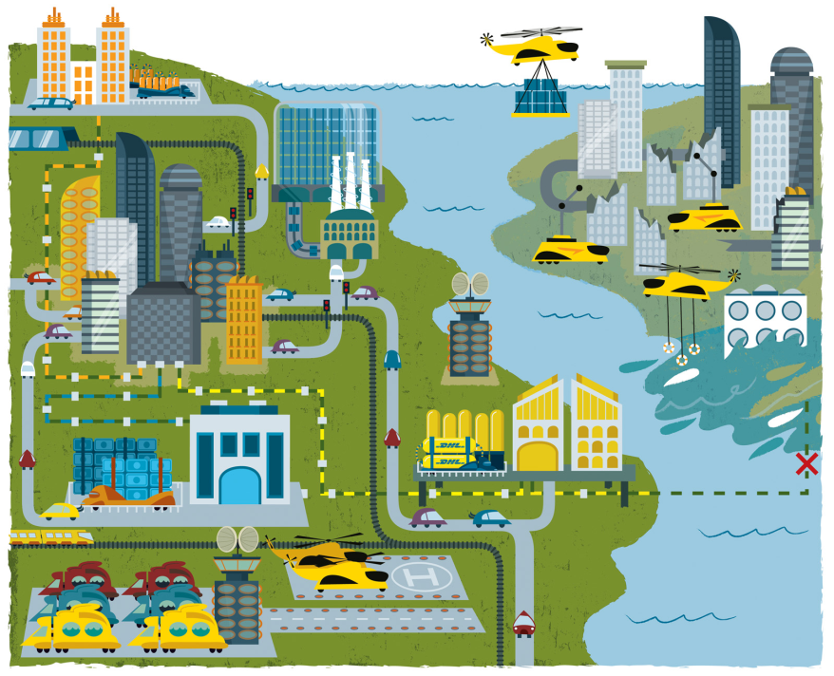
Scenario 5: Global Resilience – Local Adaptation
Key Elements
Szenario 5: Global Resilience – Local Adaptation
The run-up (first decades of 21st century):
  Numerous disasters due to climate change
  Lean production threatened (vulnerable supply chains)
  Result: change in thinking
Resilience as new economic paradigm
  Change to regionalized supply chains
  Move towards redundant systems / supply safety
  Quick reactions to production failures
  Disaster relief important
Logistics Implications
Supply security top priority
Shorter transport distances favor companies with regional roots
Logistics firms hold ready redundant capacities
  Warehouses as buffers instead of Just in Time
  Truck, train and ship fleets used as backup
Major role for international providers > financial strength
Disaster relief operations a successful business
19

Slide 20



Scenario 5: Global Resilience – Local Adaptation
Emergency logistics providers offer comprehensive
disaster response
Szenario 5: Global Resilience – Local Adaptation
Many areas frequently threatened by disasters
Huge warehouse structures located close to manufacturer as buffers
Transport capacities stand ready for emergencies

